Slide 1
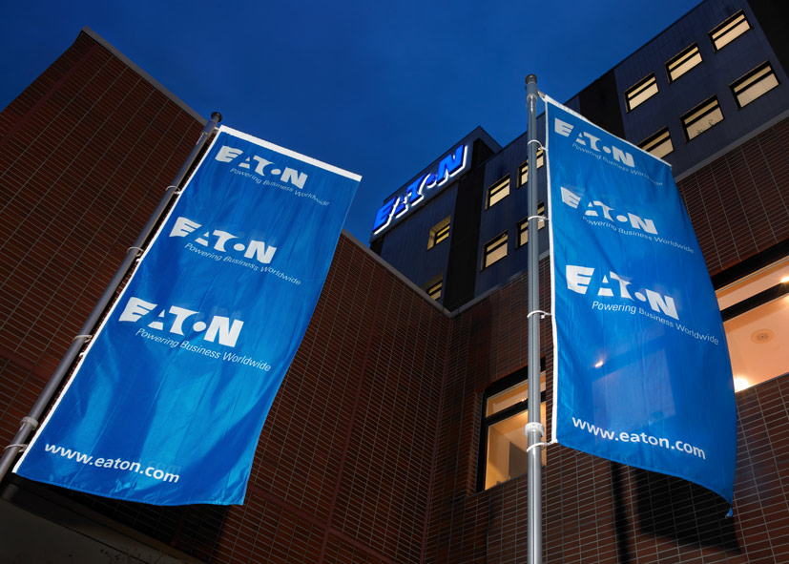
Procure to Pay
Shridhar Shetty
Notes:
Tips:
Title on this slide should be kept short.
Transparency bar is separate piece behind text. Please copy and paste the one in this slide to re-create.
Headlines should be set with an initial cap (sentence case) and the rest in lower case. Only product names or acronyms in the headline should begin with a capital letter.

Slide 2
Agenda
P2P – Definition
P2P Cycle
Determination of Requirements (MRP)
Vendor Selection
New Buy Process(PR to PO)
PO Management(Expedite, De-Expedite & Cancellation)
Goods Receipt
Invoice verification
Payment to supplier

Slide 3
P2P - Definition
Procure to pay is the process starts from Procuring the raw materials from the supplier for manufacture the Final product and ends with paying the supplier for the material purchased.

Slide 4
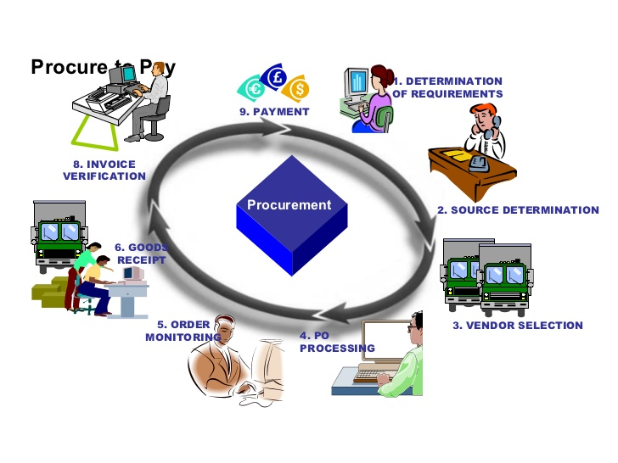
P2P Cycle

Slide 5
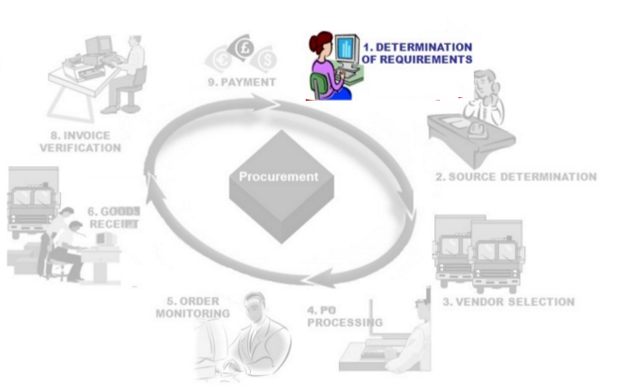

P2P Cycle

Slide 6
Determination of Requirements(MRP)
Material requirements planning (MRP) is a production planning, scheduling, and inventory control system used to manage manufacturing processes.
An MRP integrates data from production schedules with that from inventory and the bill of materials (BOM) to calculate purchasing and shipping schedules for the parts or components required to build a product
OBJECTIVES OF MRP:
Ensure right materials are available for production
On-time delivery of End product to Customer
Maintain the lowest possible Inventory
Plan delivery schedules and purchasing activities.

Slide 7
Determination of Requirements(MRP)
ADVANTAGES OF MRP:
Helps to minimize inventory level.
Track material requirements
Identifies shortage in inventory items
Helps to plan the procurement schedule.
On time delivery

Slide 8
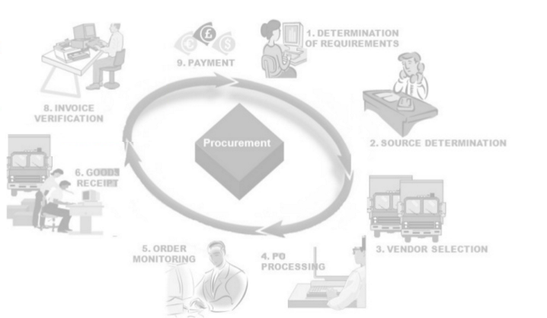
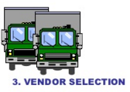
P2P Cycle

Slide 9
Vendor Selection
Vendor is an individual or company that sells goods or services to someone else in the economic production chain.
Vendor selection Criteria:
Product service and quality
Ability to meet specifications and standards
Competitive pricing
On-Time delivery of Materials
Flexibility to allow changes in orders or product lines.
Customer service
Methods of Delivery
Performance history

Slide 10
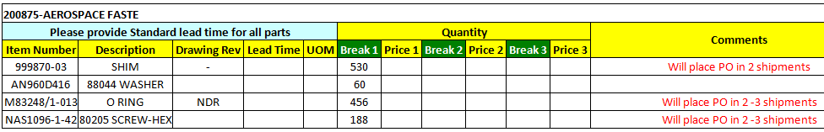
Vendor Selection
RFQ (Request for Quote) :
Requesting potential vendors to submit a quotation for a specific material or services. Quotations contains price, MOQ, Terms & conditions etc..
Buyer need to analyze the each quotes by comparing them and select the vendor’s for procure the materials

Slide 11

P2P Cycle

Slide 12
New Buy Process (PR to PO)
Once vendor finalized for the material, Buyer will release the purchase order to supplier by converting the purchase requisition (PR) to Purchase order (PO)
Purchase Requisition(PR):
It is Internal request for purchasing
This is the document that defines the need for goods and/or services.
It does not constitute a contractual relationship with any external party.
PR can be created automatically by Material Requirement Planning or Manually

Slide 13
New Buy Process (PR to PO)
Purchase Order (PO) :
Purchase order is a formal request to vendor to supply the certain materials or services under the certain conditions
The document authorizes a supplier to deliver to the buyer as requested.
Purchase order contains:
PO Number
Part Number
Quantity
Price
Delivery date
Incoterms
Terms and conditions

Slide 14
New Buy Process (PR to PO)
PO Acknowledgement:
Once PO released to supplier, Buyer has to get the PO acknowledgement from supplier within the Turn around time(TAT).

Slide 15
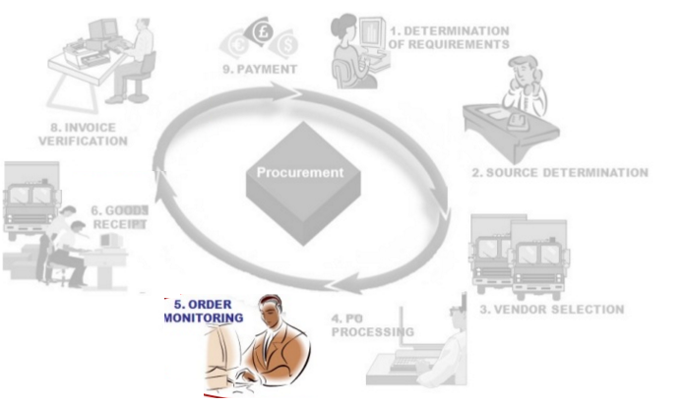
P2P Cycle

Slide 16
PO Monitoring/Management
Buyer has to monitor the PO and manage the delivery schedules as per the Demand of the customer .
Expedite :
If the production planned before the delivery date of the material, buyer has to expedite the delivery of material before the Production date.
De-Expedite:
In case of Demand push outs, Demand drops, Buyer has to de-expedite the material after the delivery date to reduce the Inventory level.

Slide 17
PO Monitoring/Management
Cancellation:
Buyer can approach supplier to cancel the Purchase order, In case of Obsolete On hand stock, Customer rejection of material, Support from intercompany sites, etc…
Shipment Tracking:
Once parts shipped from vendor place, Buyer has to get the Tracking details and follow-up with logistics team to ensure the on-time delivery of materials

Slide 18
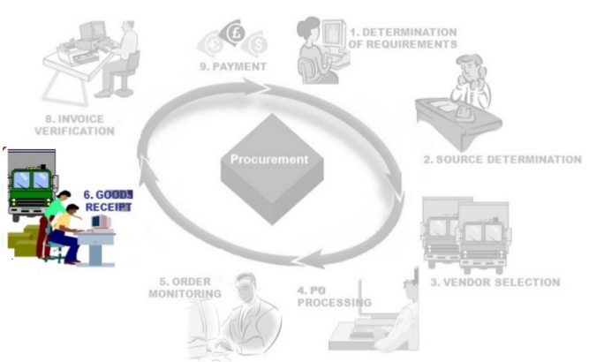
P2P Cycle

Slide 19
Goods Receipt
Once shipment delivered in Warehouse, Receiving team receive the goods and they issue GRN (Goods Receipt Number) acknowledge the receipt of the items listed in Invoice
Receiver matches goods received and Company purchase order to verify the Right Quantity, Right material, Right price, etc..
Receiving Challenges:
Document Missing (invoice, packing slip, etc.)
Damaged shipments
Incorrect Information's(PO#, Part#, Description, Vendor name)
Qty & Price mismatch
Wrong Parts

Slide 20
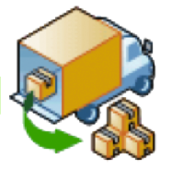



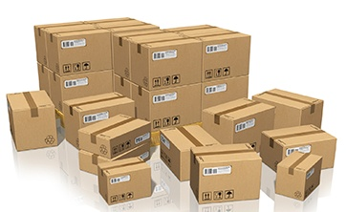
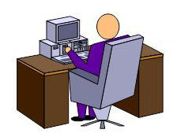
Goods Receipt - Process Flow
Generating Good receipt Number
Parts Unloading
Parts Inspection & Verification
Accounts Payable
Receiving Stores

Slide 21
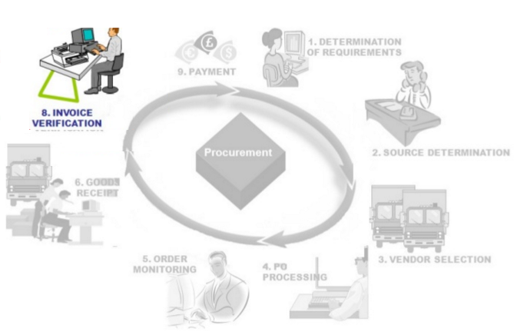
P2P Cycle

Slide 22
Invoice Verification
Once shipment sent to customer, Supplier will send the invoices to Customer Account payable(AP) team.
AP Team need to verify the Invoices with Purchase order in system in terms of Price, Quantity, etc..
If AP team found any mismatch, Invoice will go On Hold and payment stopped to supplier.
Common Errors for Invoice On Hold:
Price and Quantity Mismatch
Quantity Receive Hold
Incorrect Information
Additional Charges

Slide 23
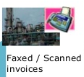


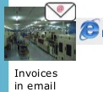
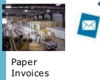

Invoice Processing Flow
Approvals
Payment Run
Accounts Payable
Discrepancy Invoices

Slide 24
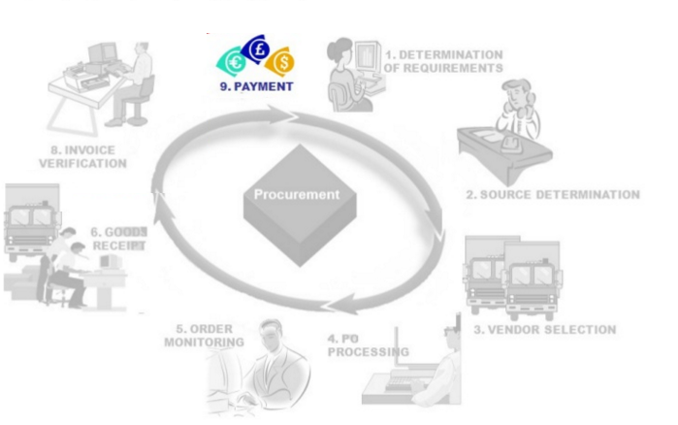
P2P Cycle

Slide 25
Payment to Suppliers
AP Team process payment to supplier’s, Once invoice gets verified.
Vendors get payment as per their Payment Terms.

Slide 26


Slide 27
Thank You…

